Slide 1
Bell Work:
1.) Create your own system of equations that has no solution.
2.) Create your own system of equations that has infinite solutions.
3.) Create your own system of equations that has one solution.

Slide 2
Bell Work:
1.) Create your own system of equations that has no solution.
Any two equations that have the same slope but different y-intercepts will work (lines are parallel!)
2.) Create your own system of equations that has infinite solutions.
Any two equations that are EXACTLY the same! The lines have to over lap – infinity intersections.
3.) Create your own system of equations that has one solution.
Any two equations that have different slopes will intersect one time!

Slide 3
From Last Time
Page 153 #19, 23, 55, 66, 67, 72
Page 179 #7, 10, 17, 23, 24, 29

Slide 4
ALGEBRA 3
Day 28

Slide 5
Objective: To solve a system with three variables.

Slide 6
3.5 Solving Systems with 3 Variables
You can use elimination and/or substitution to solve a system of three equations in three variables by working with the equations in pairs. (You’ll use one of the equations two times.)
Solution: (x, y, z)

Slide 7
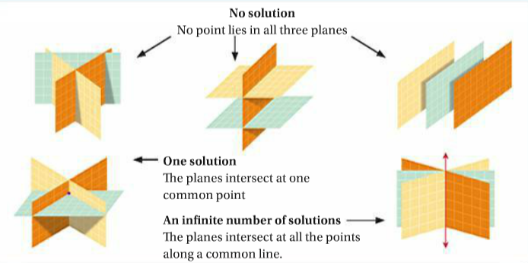
Same type of solutions as before… (you don’t need to try and draw these!)
-You can have No Solution (no point lies in all three planes)
-You can have One Solution (the planes intersect at one common point)
-You can have Infinitely Many Solutions (planes intersect at all points along a common line)

Slide 8

Example: Solve the system for (x,y,z)
1.)
$$x+y+z=8$$
$$x−z=2$$
$$4x−12=0$$

Slide 9
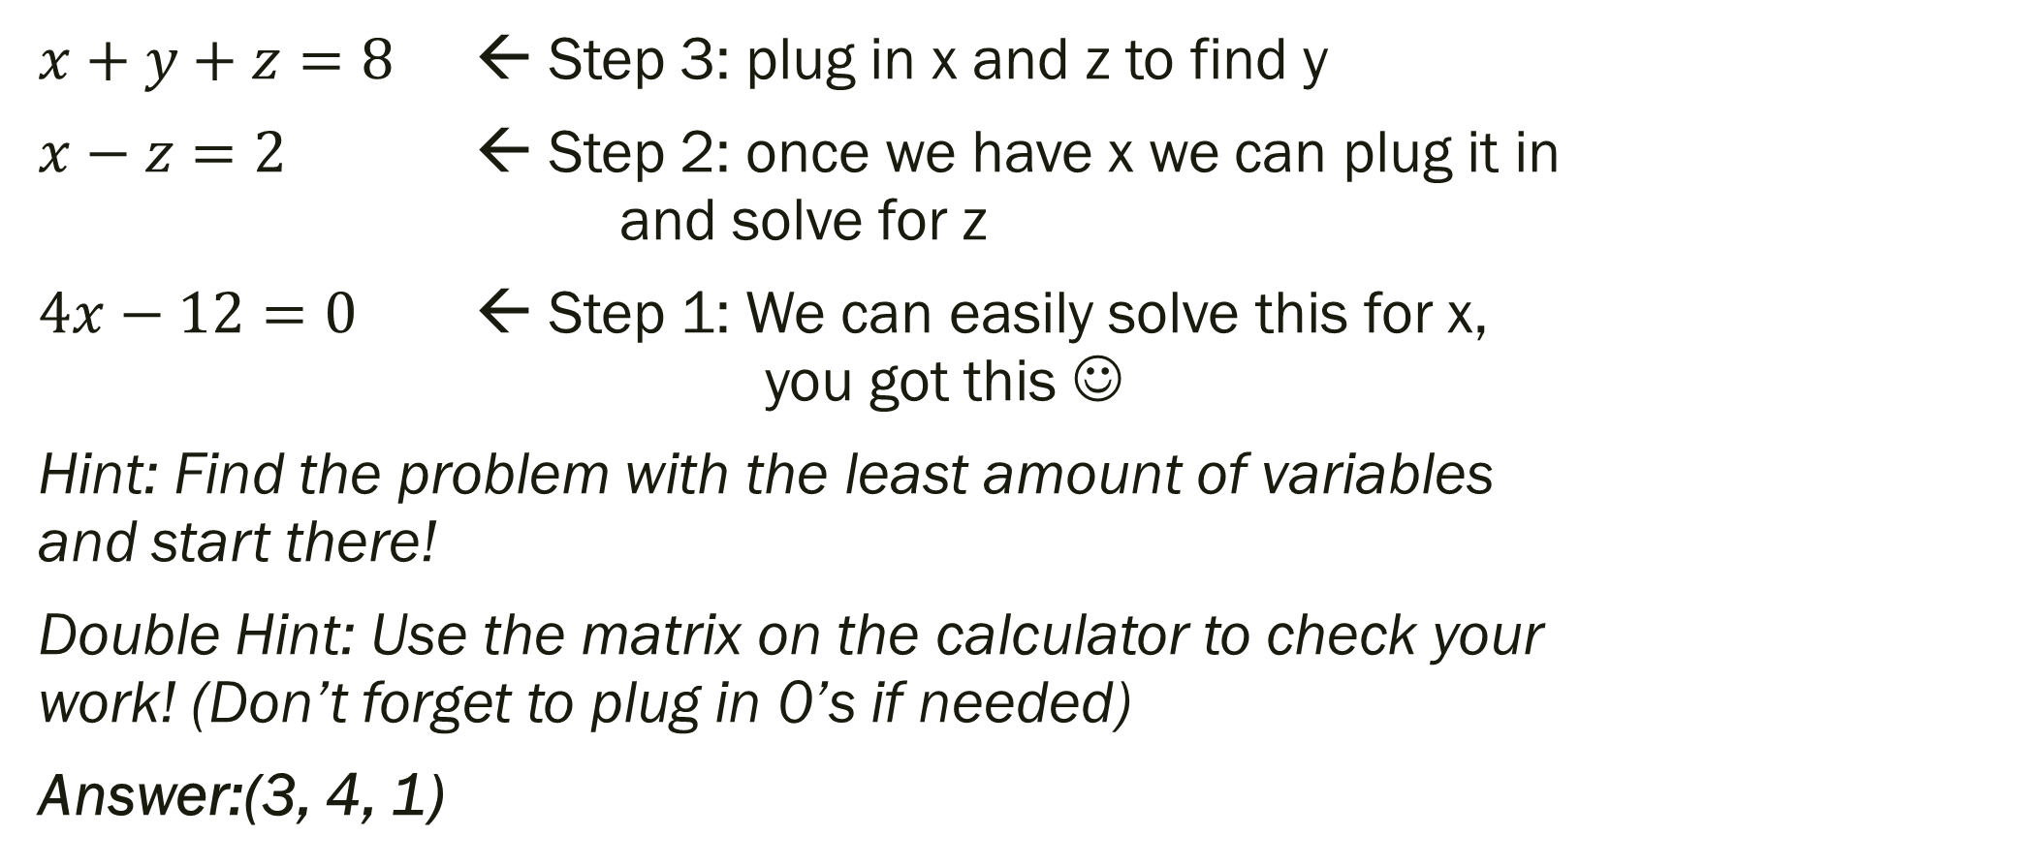
Example: Solve the system for (x,y,z)
1.)
$x+y+z=8$ ← Step 3: plug in x and z to find y
$x−z=2$ ← Step 2: once we have x we can plug it in and solve for z
$4x−12=0$ ← Step 1: We can easily solve this for x, you got this ☺
Hint: Find the problem with the least amount of variables and start there!
Double Hint: Use the matrix on the calculator to check your work! (Don’t forget to plug in 0’s if needed)
Answer:(3, 4, 1)

Slide 10

Example: Solve the system for (x,y,z)
2.)
$$x+y +2z=3$$
$$2x+y +3z=7$$
$$−x−2y+z=10$$

Slide 11
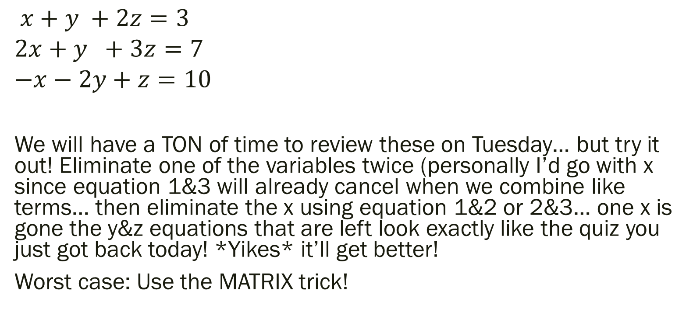
Example: Solution…
2.)
$$x+y +2z=3$$
$$2x+y +3z=7$$
$$−x−2y+z=10$$
We will have a TON of time to review these on Tuesday… but try it out! Eliminate one of the variables twice (personally I’d go with x since equation 1&3 will already cancel when we combine like terms… then eliminate the x using equation 1&2 or 2&3… one x is gone the y&z equations that are left look exactly like the quiz you just got back today! *Yikes* it’ll get better!
Worst case: Use the MATRIX trick!

Slide 12
For Next Time
New Material:
Page 171 #2, 21, 23
Mixed Review:
Page 173 #51, 54, 55, 56

